Slide 1


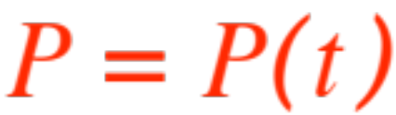
What’s going on out there?
(way out there!)
Suppose you are studying the increase or decrease of a population over time.
Somebody gave you a formula that presumably describes the amount of members of the population at a given time , that is a function
.
You’d like to be able to predict what happens to the population as time goes by.
We have to make precise what we mean by “as time goes by” and “what happens to “.

Slide 2

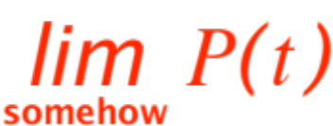




We know how to handle “what happens to .”
It’s just a limit !
We must give meaning to
and it should mean “as time goes by.” The everyday interpretation of the English phrase is that time just keeps rolling past any bound. We translate that into Mathematical symbolism with the icon (read “ as goes to plus infinity”)
WARNING ! The symbol is NOT a number, it just stands for any process that keeps
rolling past any bound .

Slide 3
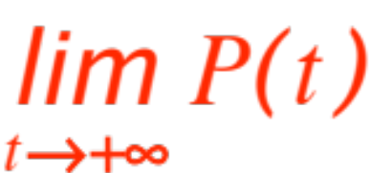
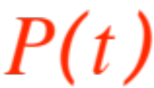

So, in the expression we replace
with the icon and get
Whatever that symbol is going to mean, that is the meaning of
“what happens to P as time goes by” and more colorfully, the title of this presentation:
Let’s ask: “what can happen to as rolls past all bounds?” I see three possibilities:
What’s going on out there?
(way out there!)

Slide 4
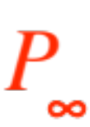
grows consistently beyond all bounds
(and takes over the planet, or destroys it)
approaches an equilibrium value
(that may be 0, in which case we say that
is extinct.)
behaves wildly (inconsistently and unpre-dictably, like us humans who decrease our numbers through war, illnesses and famine, but increase it through better medical care and unrestricted reproduction; who knows
what will happen to us way out there … )
Since we prefer predictable behavior, we write:

Slide 5
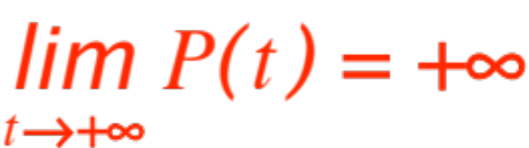
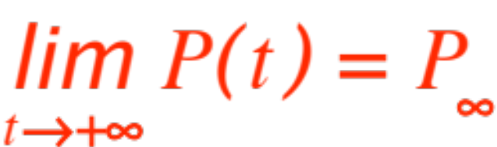

In case 1
to be made precise
In case 2
to be made precise
In case 3
not much to do ☺
Let’s go for precision.

Slide 6




Definition 1. The statement
means that (all Math now, ready?)
In the usual definition of limit both and are supposed to be “small”. Here, a moment’s reflection will show you that and are sup-posed to be “big” (doww, they may be written as
and ), but ‘bigness’ and ‘smallness’ are meaningless concepts here.
Next definition.

Slide 7
Definition 2. The statement
means that (all Math now, ready?)
Note that in this case should be “small”, (you want to get close to ), but should actually be “big” ( you want to see what happens way into the future.)
I told you big and small are meaningless!
Next definition.
Definition 3. Neither Definition 1 nor Definition 2 apply. ☺

Slide 8
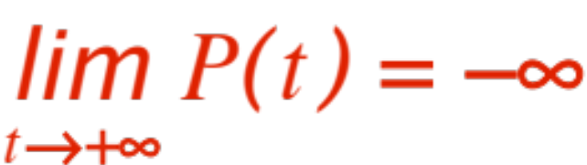
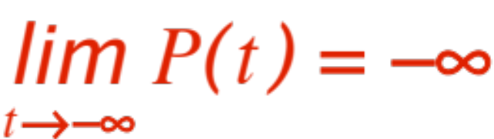

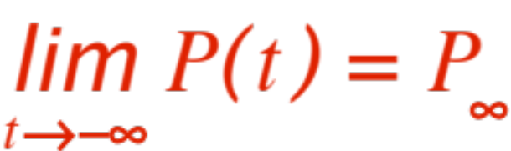
Four more versions of Definition 1 can be written (you write the definitions!)
Just for fun, let me do the top-right in Math language (ready?)
Now we look at a few examples of populations.

Slide 9
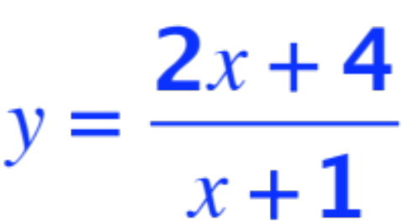
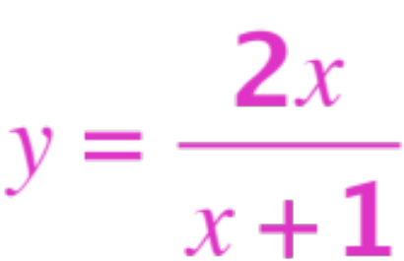
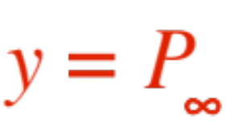
The next figure shows the behavior of two populations, one blue, one violet. The blue starts with 4 (in gazillion) members but, due to overpopulation, shrinks down to 2.
The violet population starts at 0 gazillions, and, through parthenogenesis, ends up with 2 also !
For those of you mathematically savvy, the two equations are (roughly)
and
Here are the two graphs. The red line is

Slide 10
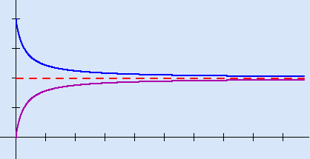
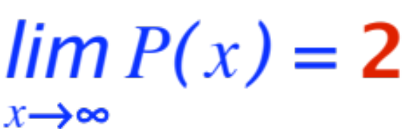
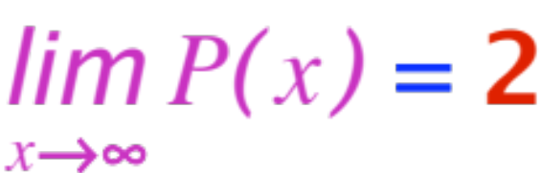
Note that the two graphs are NOT exact, but:
and

Slide 11
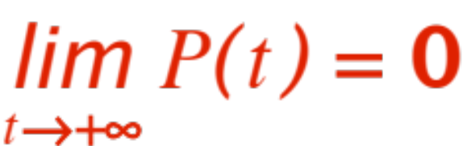
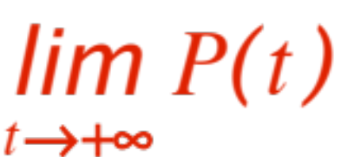

Two more figures, one of a population that starts big and oscillates down to extinction, and one of a population that starts very small and fluctuates (what’s the difference between the two words?) beyond all bounds.
In the first case we have
In the second case we have
Here are the two figures

Slide 12
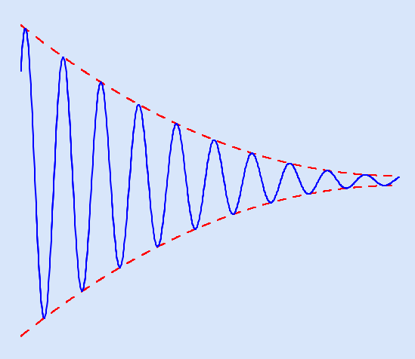
The doomed population:

Slide 13
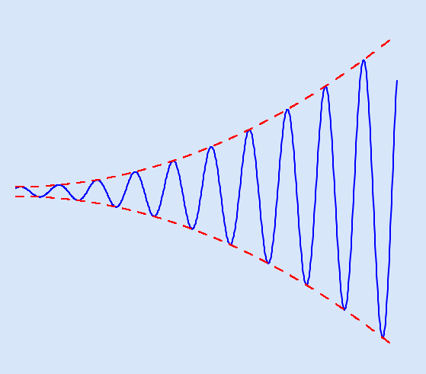
and the “wildly varying” one:

Slide 14
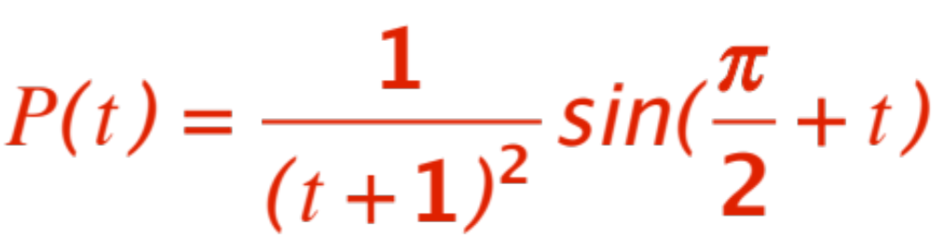
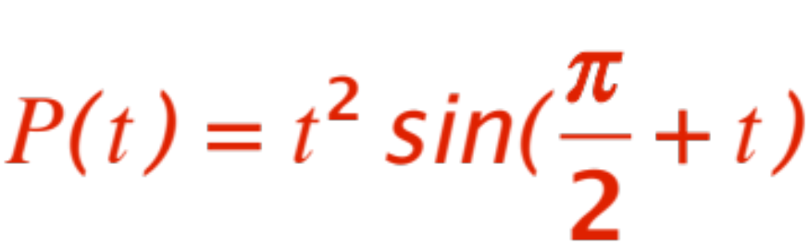
The respective (approximate) equations are:
The doomed population:
The wildy varying population:
(check them out !)

Slide 15
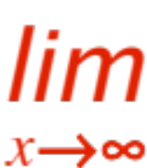
Time to get serious about this business!
We already have 6 (six, count’em !) definitions, what do we do with them?
As we did before, we build ourselves a few
Ingredients to use, … and
Tools to handle the ingredients.
The tools are the usual limit laws they are the same as before, mutatis mutandis, we will re-write them here for completeness’ sake.
We start with the tools first.

Slide 16
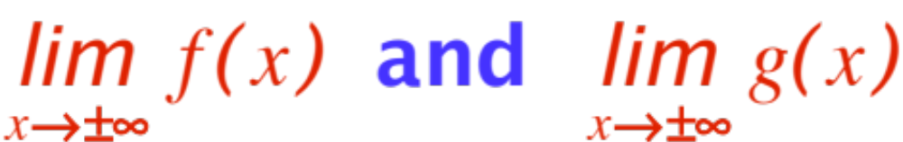
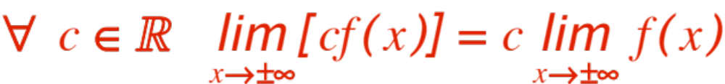
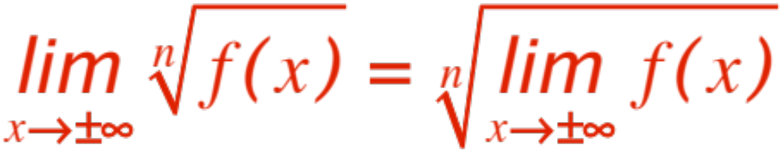
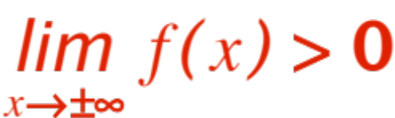

Limit laws:
Assume that both exists (finite !) Then
assuming that
when is even.

Slide 17
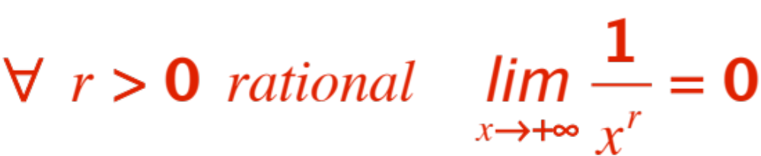
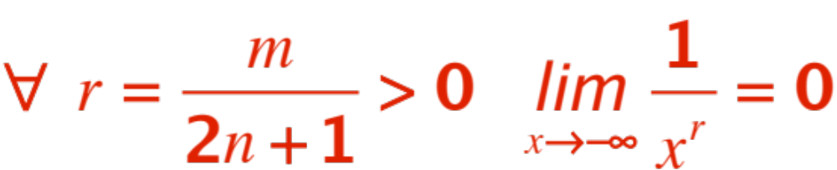

Now a few Ingredients:
We put together the whole thing with the following

Slide 18
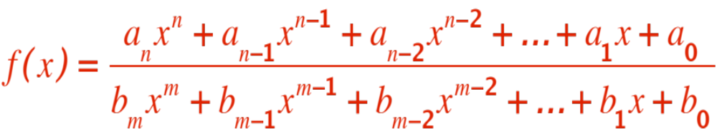
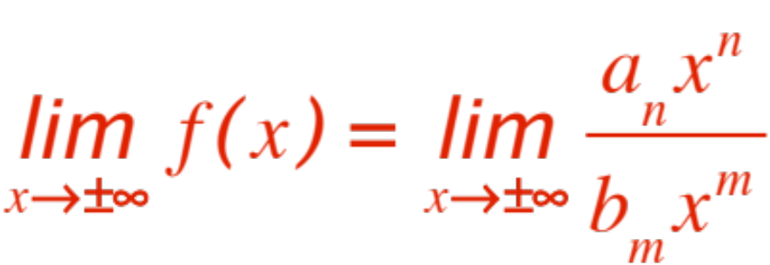
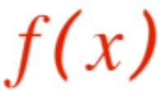
Theorem. Let
Then
Proof. The proof uses our old friend, the Agreement Theorem. We rewrite differ-ently and get our proof. Here we go:

Slide 19
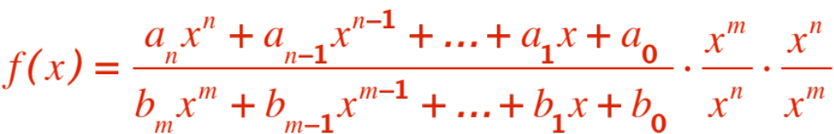
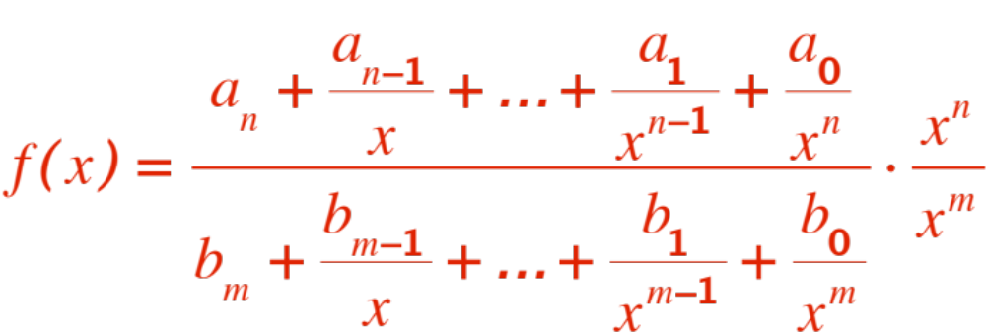

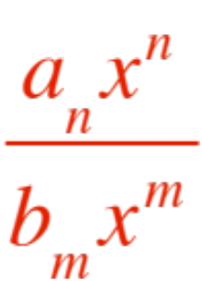
Then
If we let all terms disappear but for
QED

Slide 20
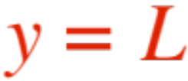
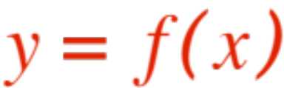
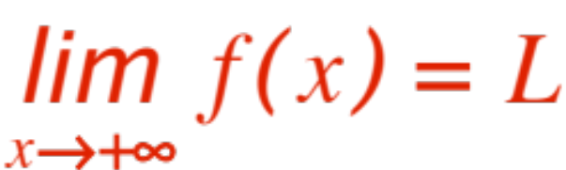

One last bit of terminology:
A horizontal straight line is said to be a
“horizontal asymptote of “ if at least
one of the two statements or
holds.
Remark. It is possible that only one of the two statements holds, or both, as the following figures show.

Slide 21
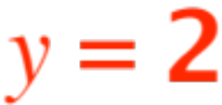
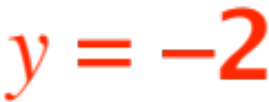
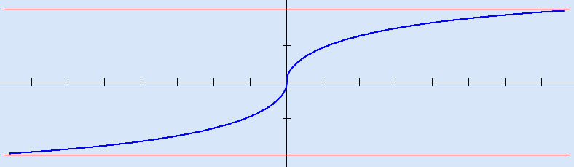
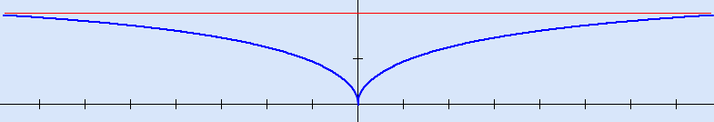
Both and are horizontal asymp-totes.
However, both limits also may hold.
is a horizontal asymptote.

Slide 22

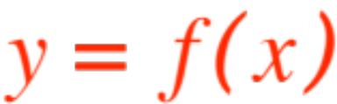
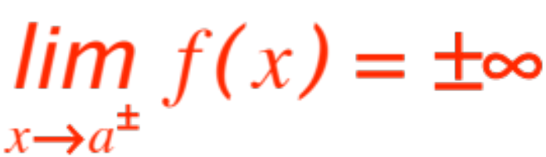
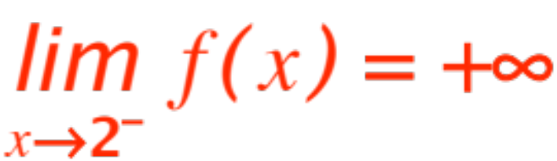
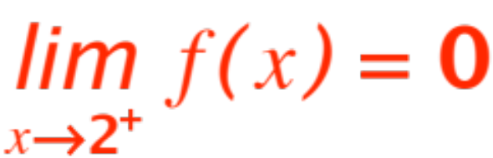
Finally, a vertical straight line is said to be
a “vertical asymptote of “ if at least
one of the following four (count ‘em) statements hold:
Again, only one of the four need hold (it’s impossible for all four to hold, why?)
Here is a figure where
but
(Note that the x-axis is a horizontal asymptote)

Slide 23
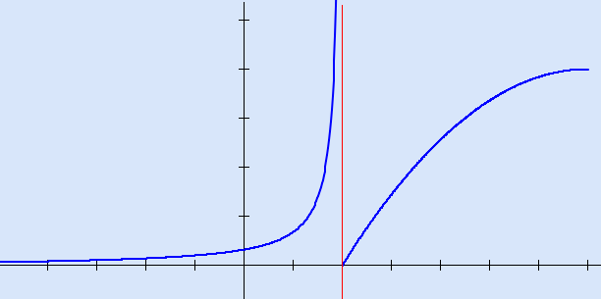
Remark. For rational functions the vertical as-ymptotes are usually found among the roots of the denominator. (Not all roots need be asymp-totes) Other functions, you’re on your own !

Slide 24
The next presentation (on graphing) will give us plenty of opportunities to work out
EXAMPLES
of limits at infinity (horizontal asymptotes if finite) and of infinite limits (vertical asymptotes.)
STAY TUNED FOLKS!

